Slide 1



CITY VISION
Earth And US
Live Smart
Represented By:
Rana El-Kady
Nehal Mahfouz
Team members:
Rana El-Kady Nehal Mahfouz
Ahmed Youssry Amr Ahmed

Slide 2
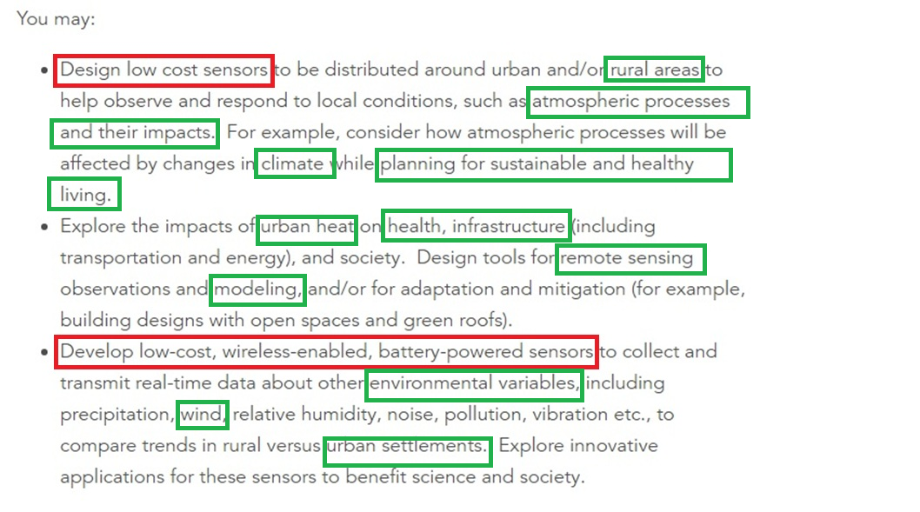
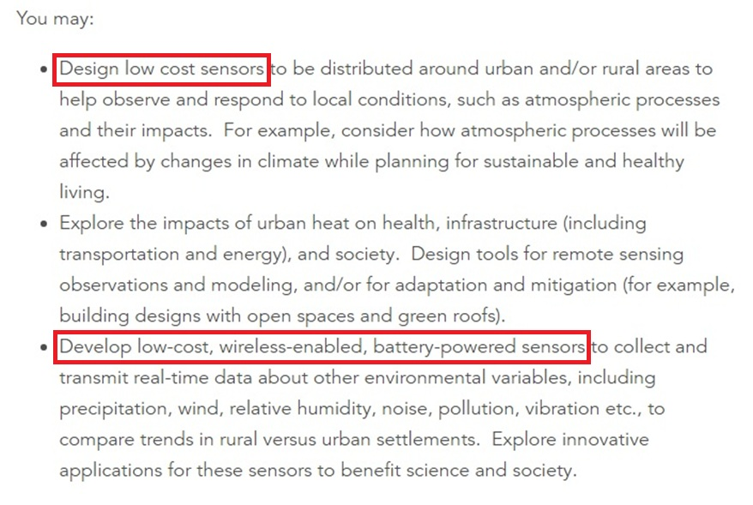
Challenge Purposes and Achievements
There are a large set of variable sensors which provide giant data categories ; so we decided that sensors are not the issue itself , it is better to focus on about how to use the acquired data and to integrate them.

Slide 3
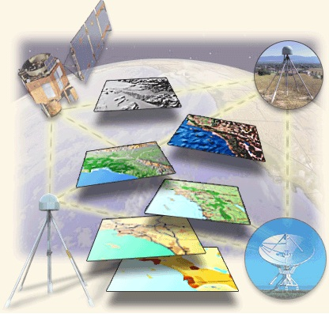
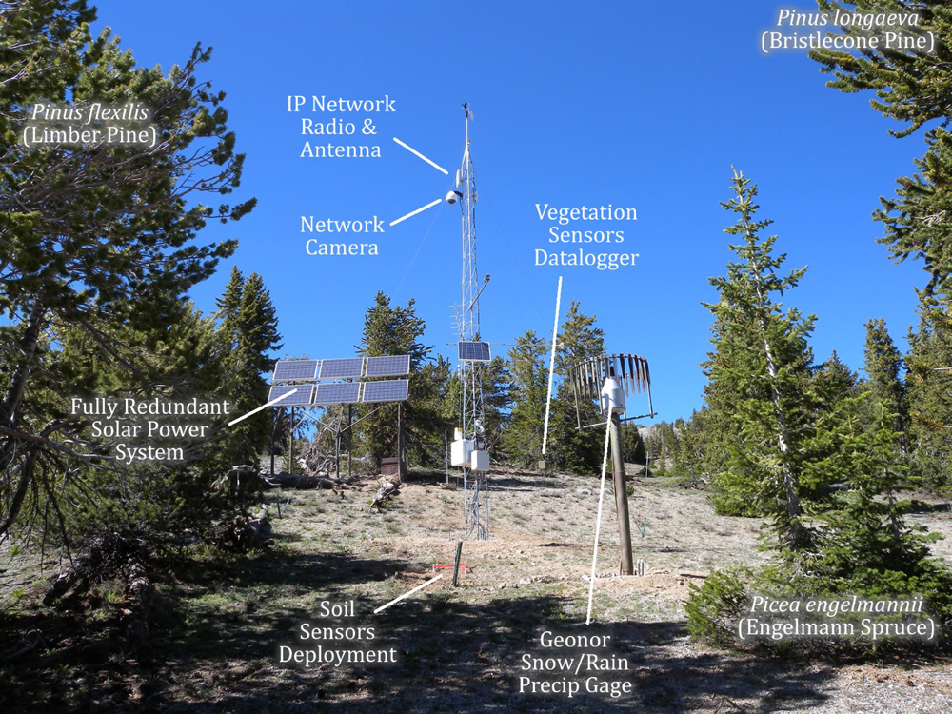
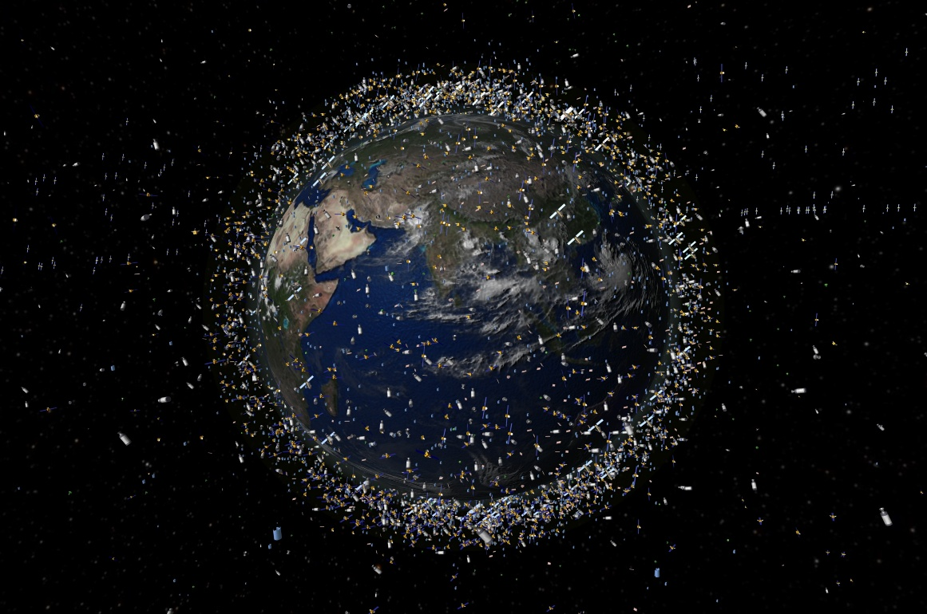
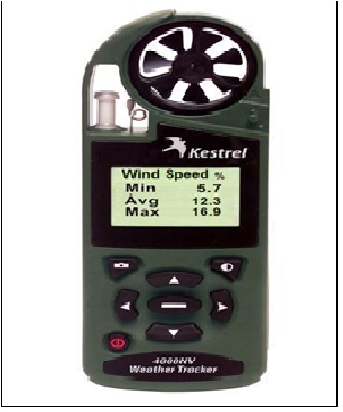
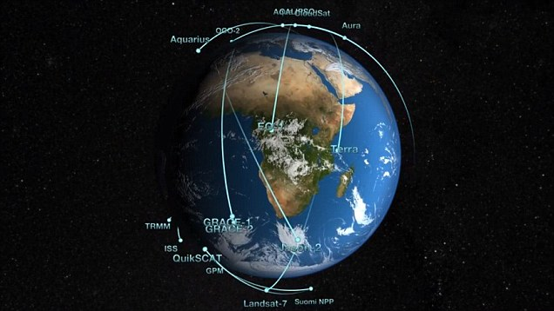
Having Huge amount sensors not connected

Slide 4
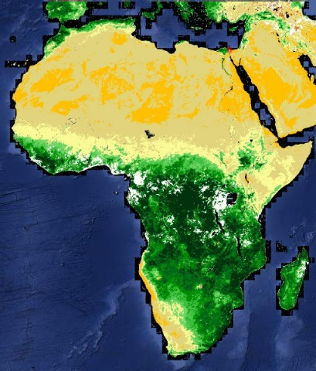
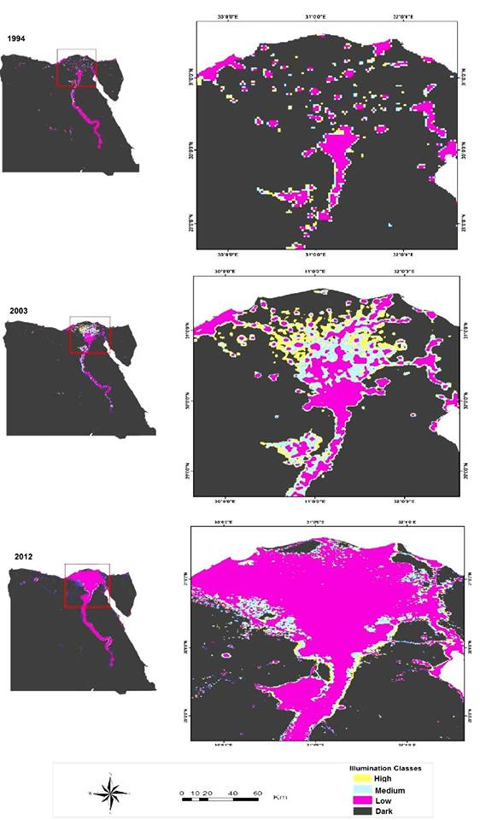
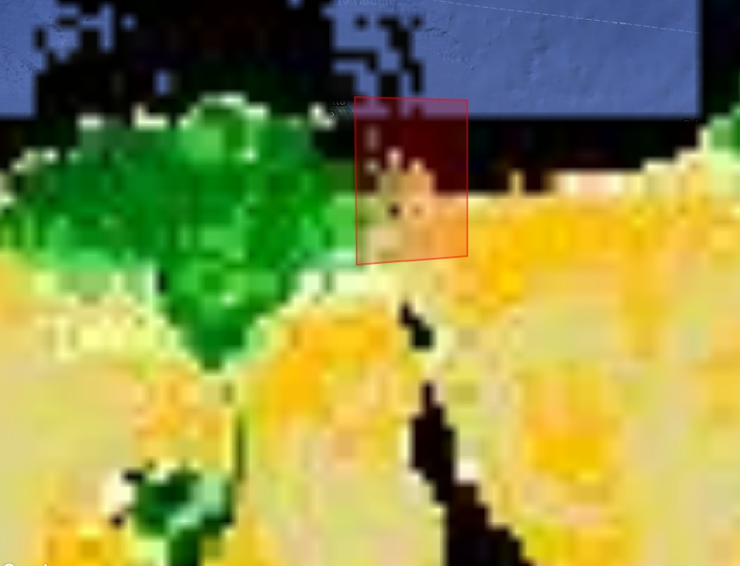
The Problem due to
The Low Resolution of some Satellite Images used Such as VIIRS and eMODIS NDVI

Slide 5

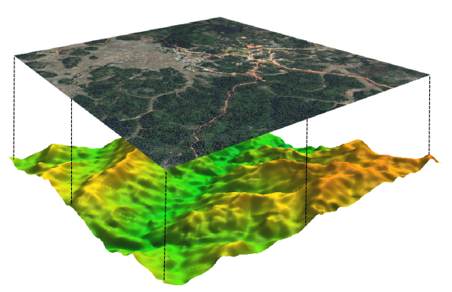
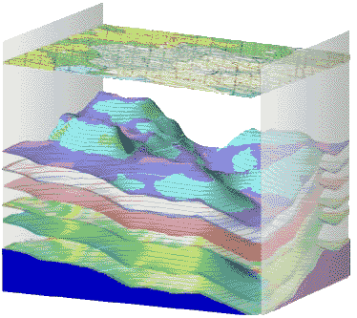
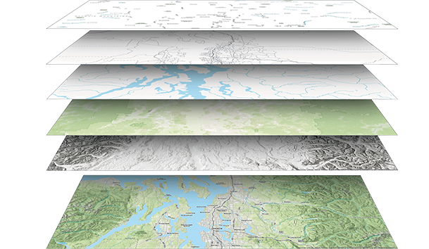
Materials and Methods (Modeling Code)
Satellite Imagery
Field &Lab Data
Sub Surface Data
Field & Lab Data Used :
Climatic Data
Elevation Data
Hydrogeology
Hydro-geochemistry
Data: Created:
Interpolated Wind potential mapping
Rain intensity map
DEM
Groundwater chemistry & resource maps
Satellite Data Used :
Land Sat MSS - Land Sat 4 , 5
Land Sat 7 - Land Sat 8
Data: Created:
NDVI
Thermal Map
Coastline Change detection
Urban and Roads
Sub Surface Data Used :
Gravity and Magnetic Survey Data
Borehole Data
Data: Created:
Deeper Tectonic Framework (Faults) Map
Subsurface Geologic layers maps

Slide 6

Materials and Methods
Satellite Imagery
Field Data
Sub Surface Data
Code

Slide 7
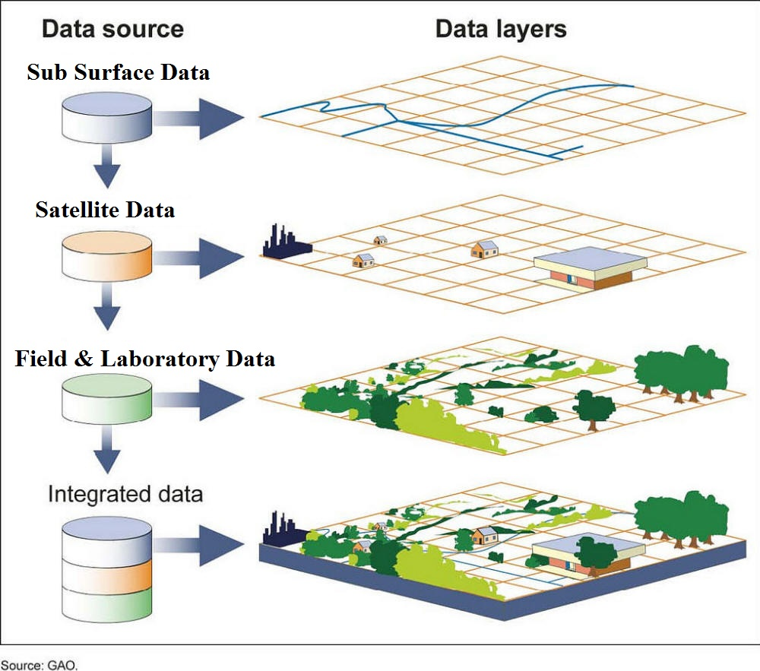
Materials and Methods
Urban Code (Strategic Plan)
Advantage of the
Modelling Solution
1- Applicable on large packages of Data varieties.
2- Codes could be easily edited or changed.
3- integrated easily on Mobile App or website to be used all over the world.
4- Used not only for urban planning but also in site selection.
5- suitability index of the project could be used to decide optimum wind farm sites.

Slide 8
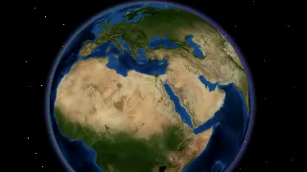
Study Area: North East of Egypt

Slide 9
Plan of Work
Soil properties
Collecting data from field observations and Satellite Image
Lithology properties
Geo-Environmental Code for urban planning of Port Said Governorate
(Master Strategic Plan)
Groundwater
Urban and Roads
laboratory analysis
Subsurface geologic structures
Climatic Data
DEM & Sea – level rise
Applying the GIS & RS techniques
Coastal erosion

Slide 10
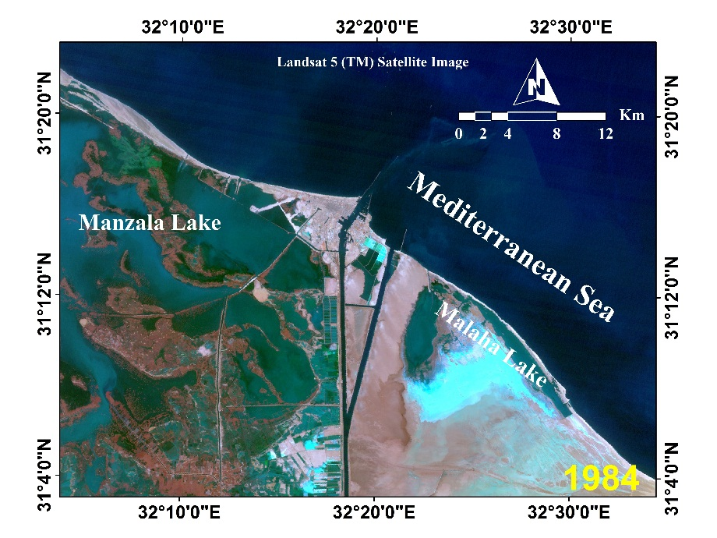
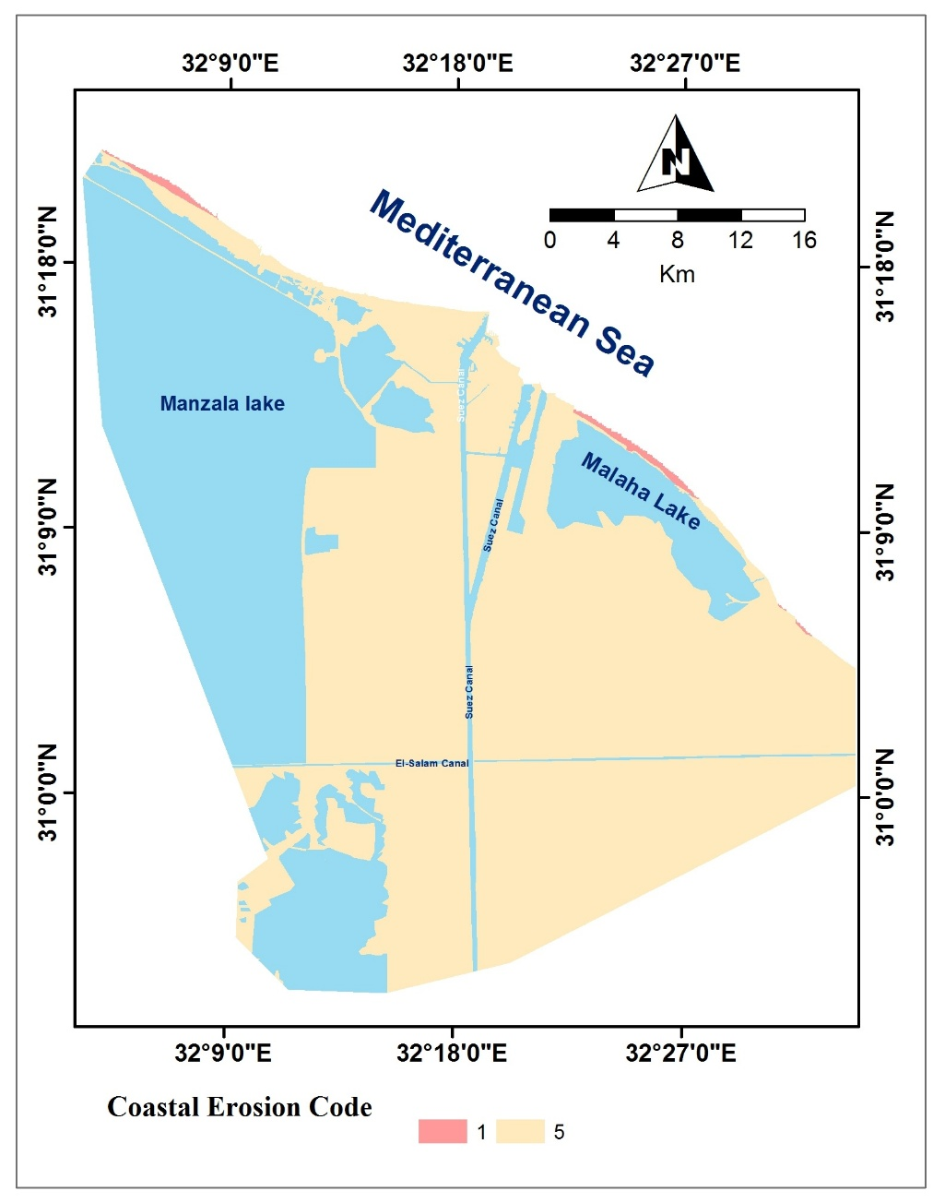
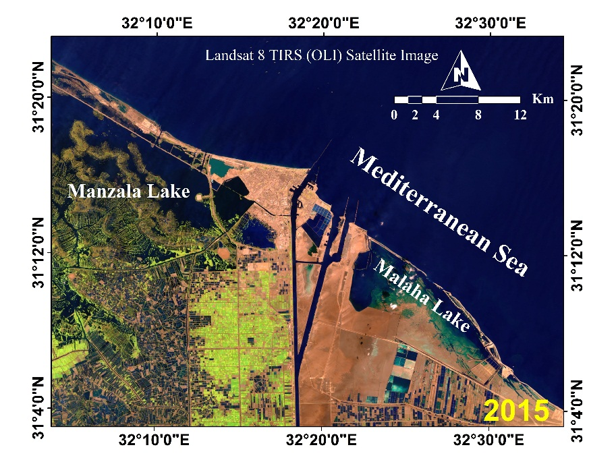
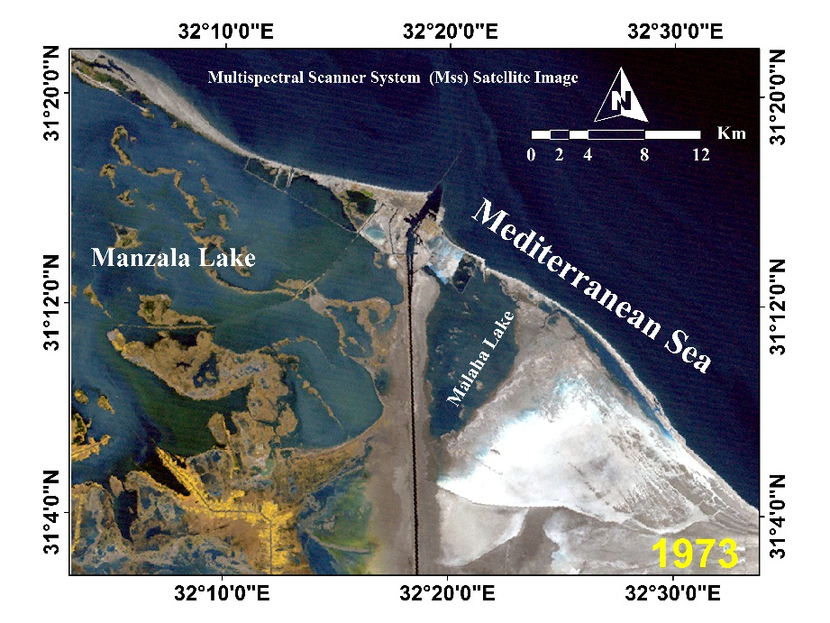
Coastal Erosion Processing and Code
Satellite Imagery
Multispectral Scanner System (Mss)
Bands 4,3,2
Landsat 5 (TM)
Bands 3,4,2
Landsat 7 (ETM)
Band 7,4,2
Landsat 8 TIRS
Band 7,5,3

Slide 11
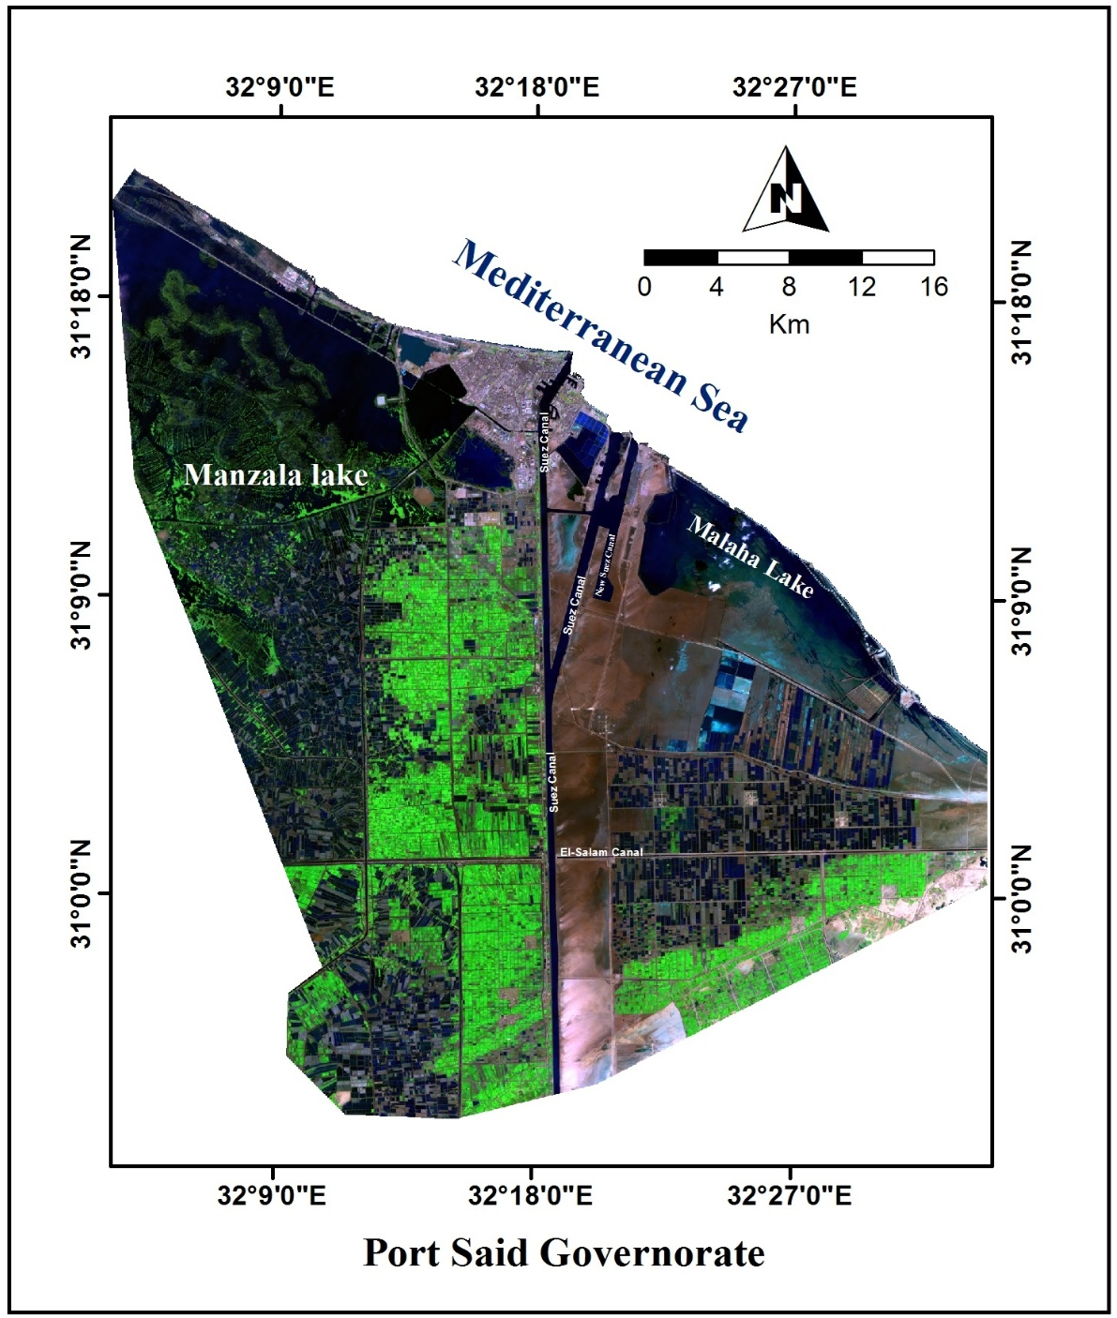
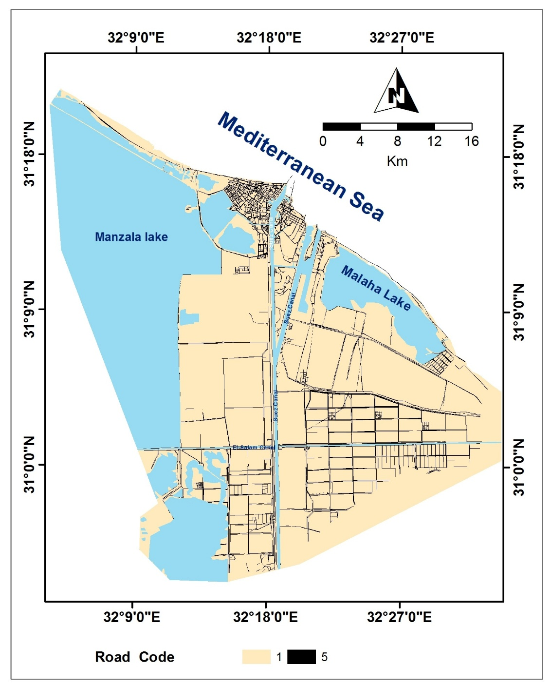
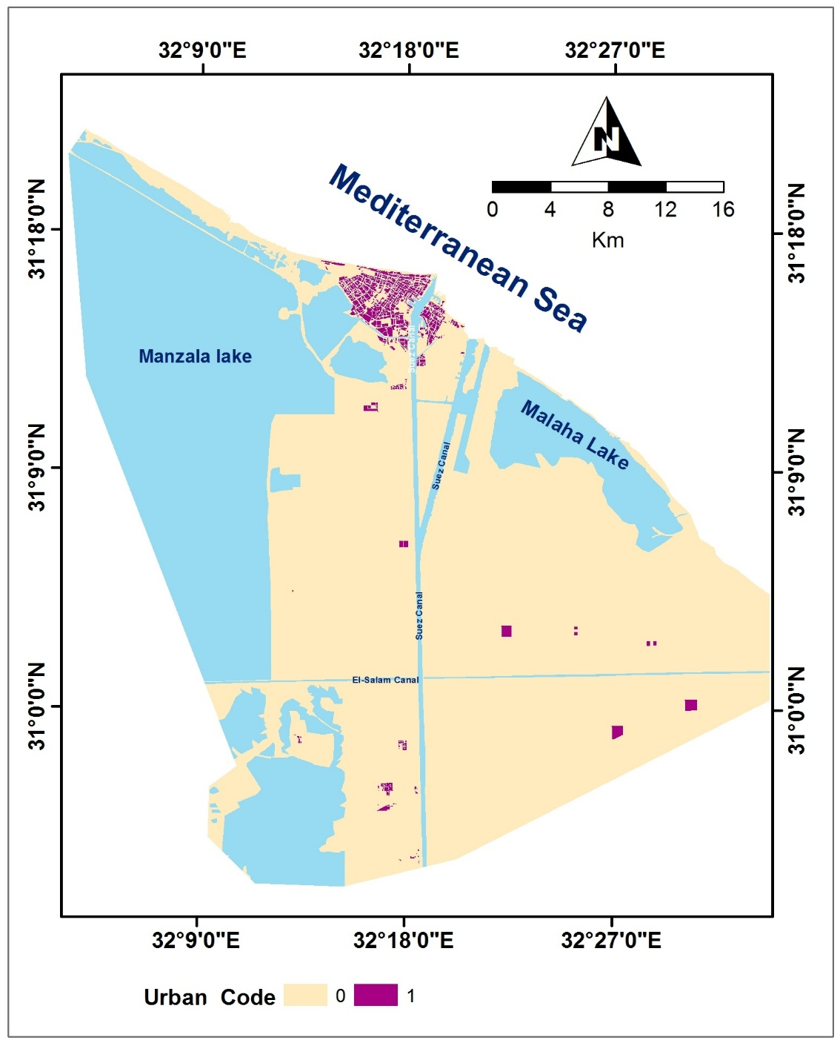
Urban and Road Code
Satellite Imagery

Slide 12
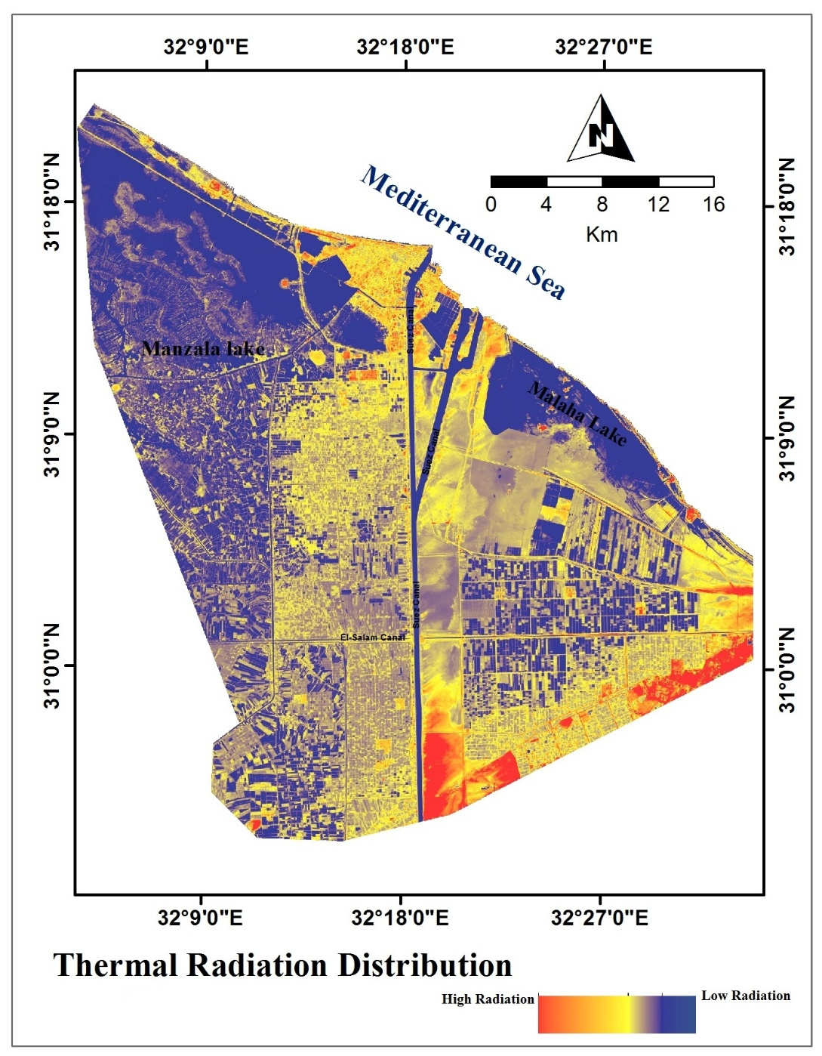
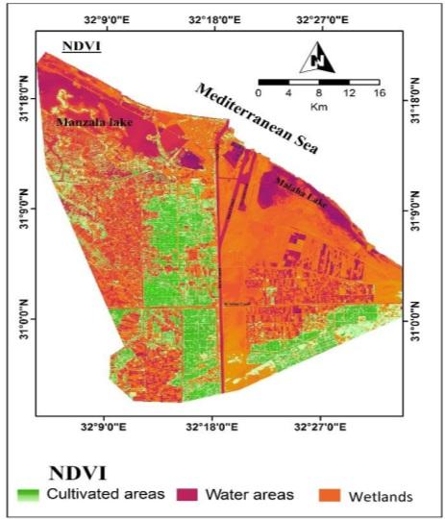
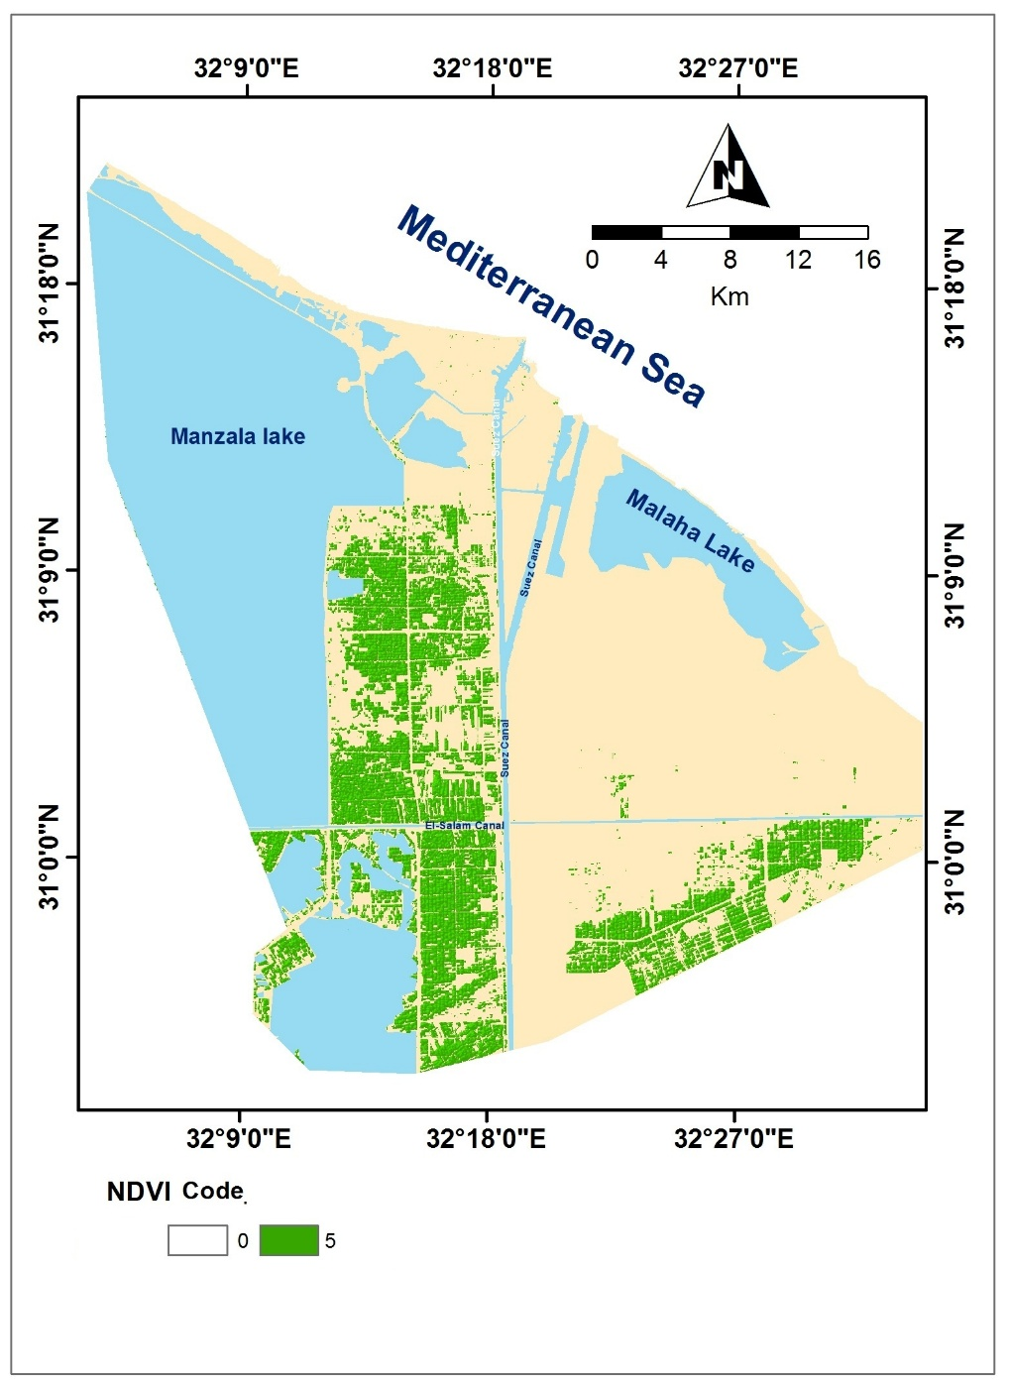
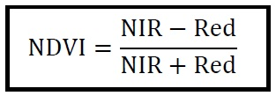
Satellite Imagery
Thermal Radiation Code
Normalized Difference Vegetation Index (NDVI) Code

Slide 13
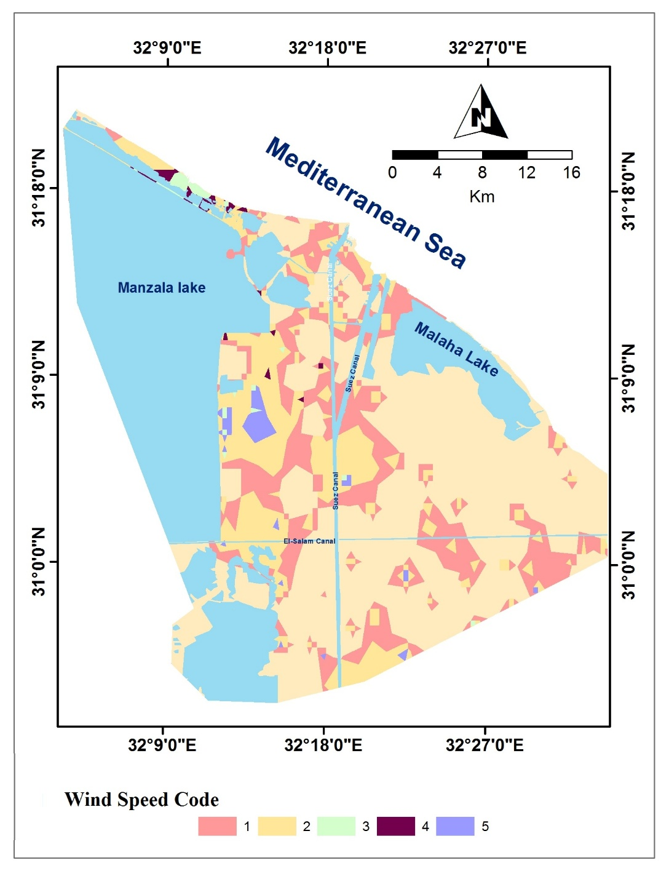
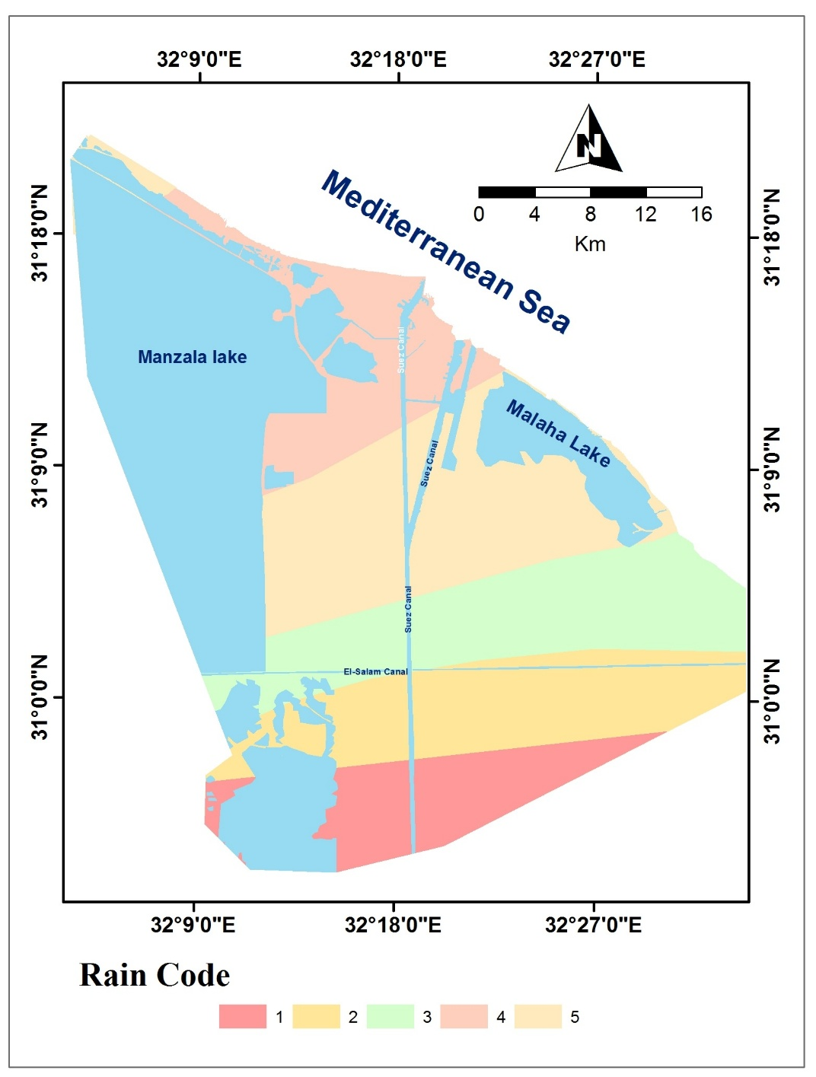
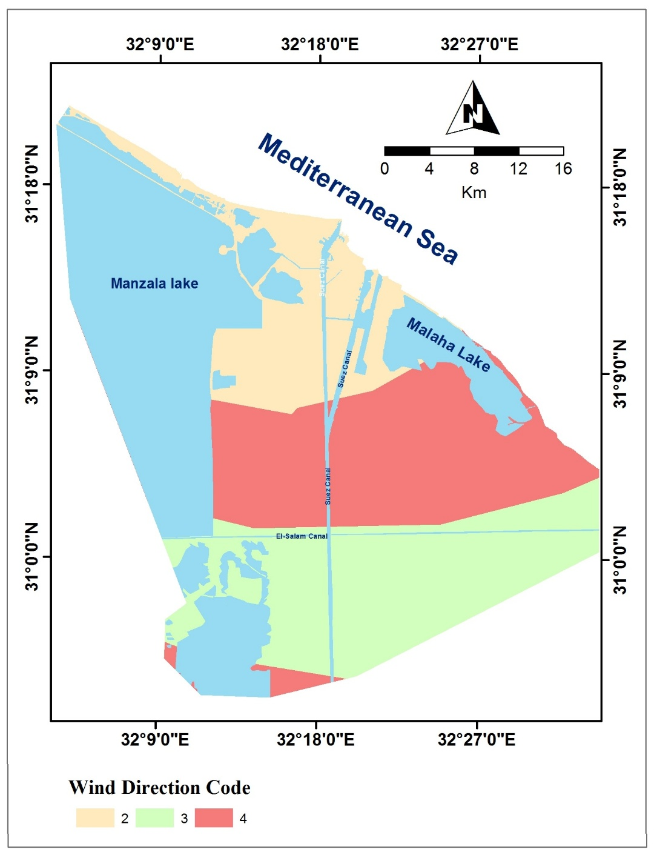
Field &Lab Data
Climatic Data
Interpolated Wind potential mapping Code Rain intensity code

Slide 14
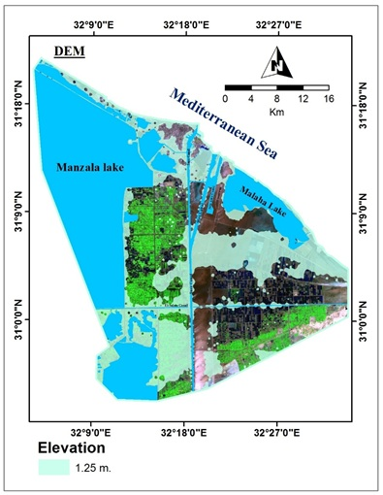
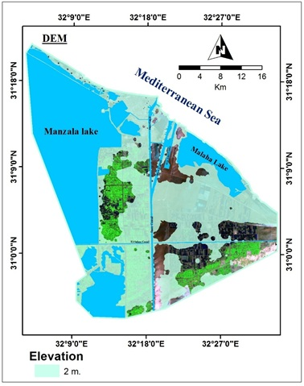
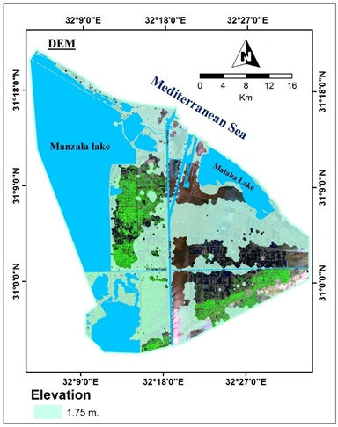
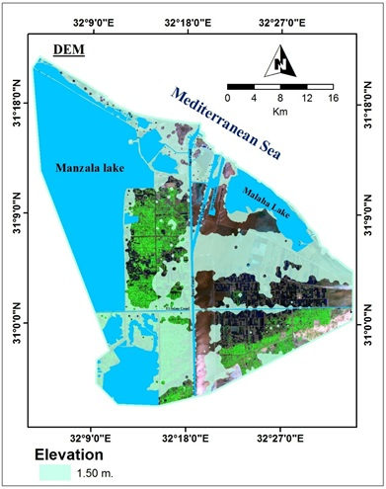
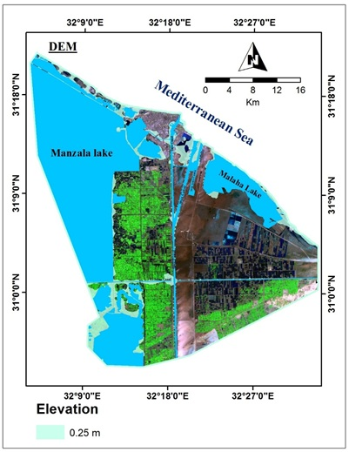
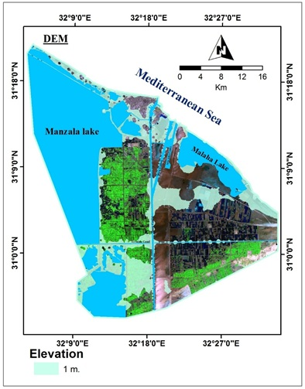
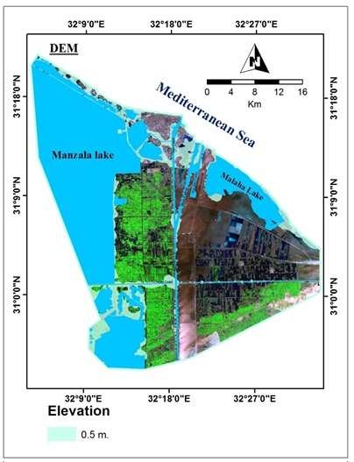

Elevation
Field &Lab Data
DEM Code

Slide 15
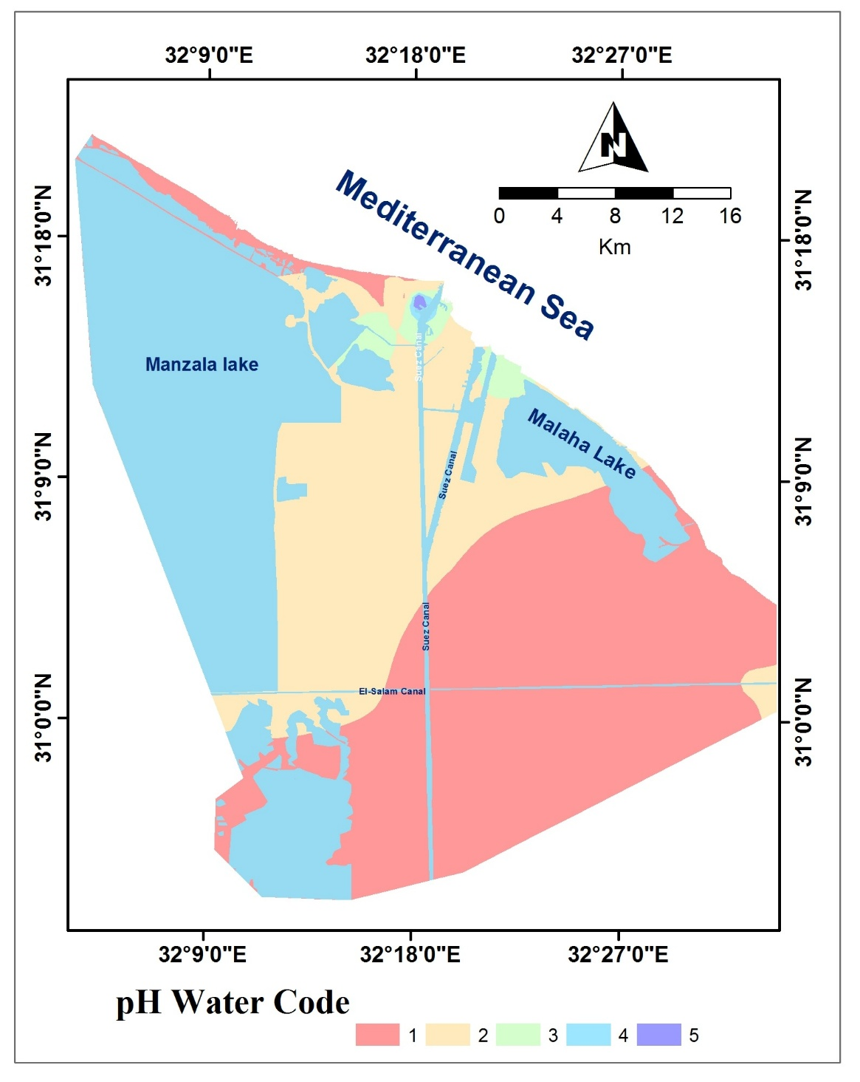
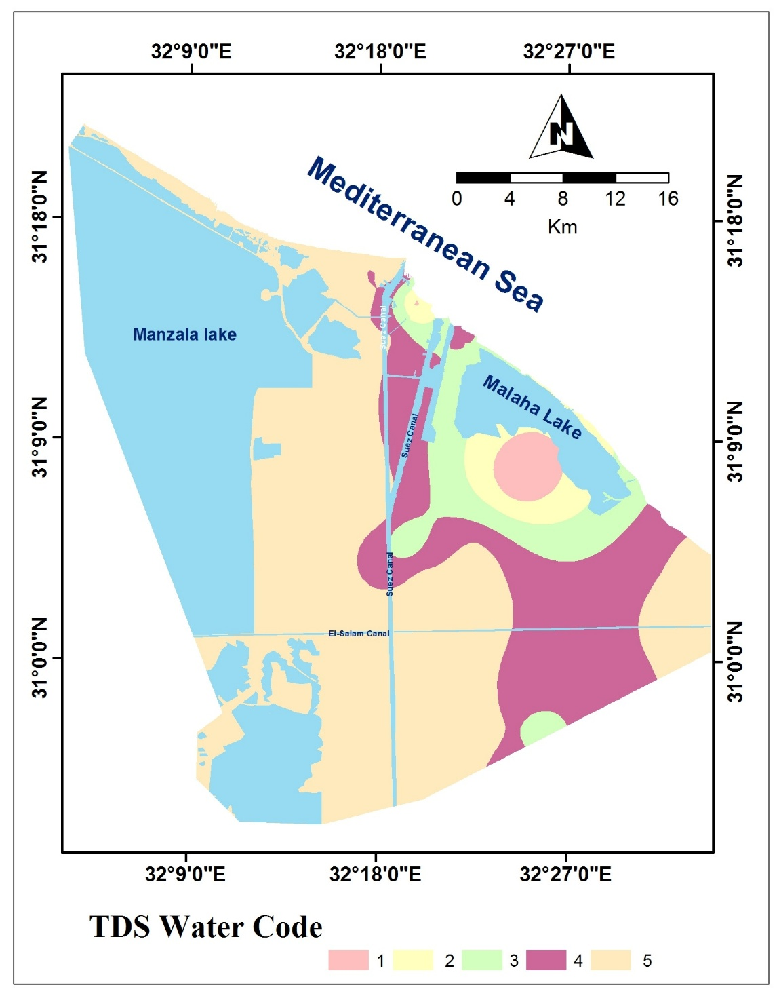
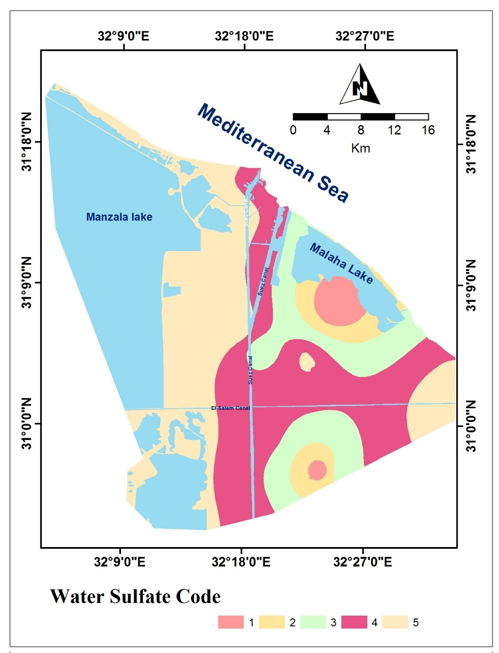
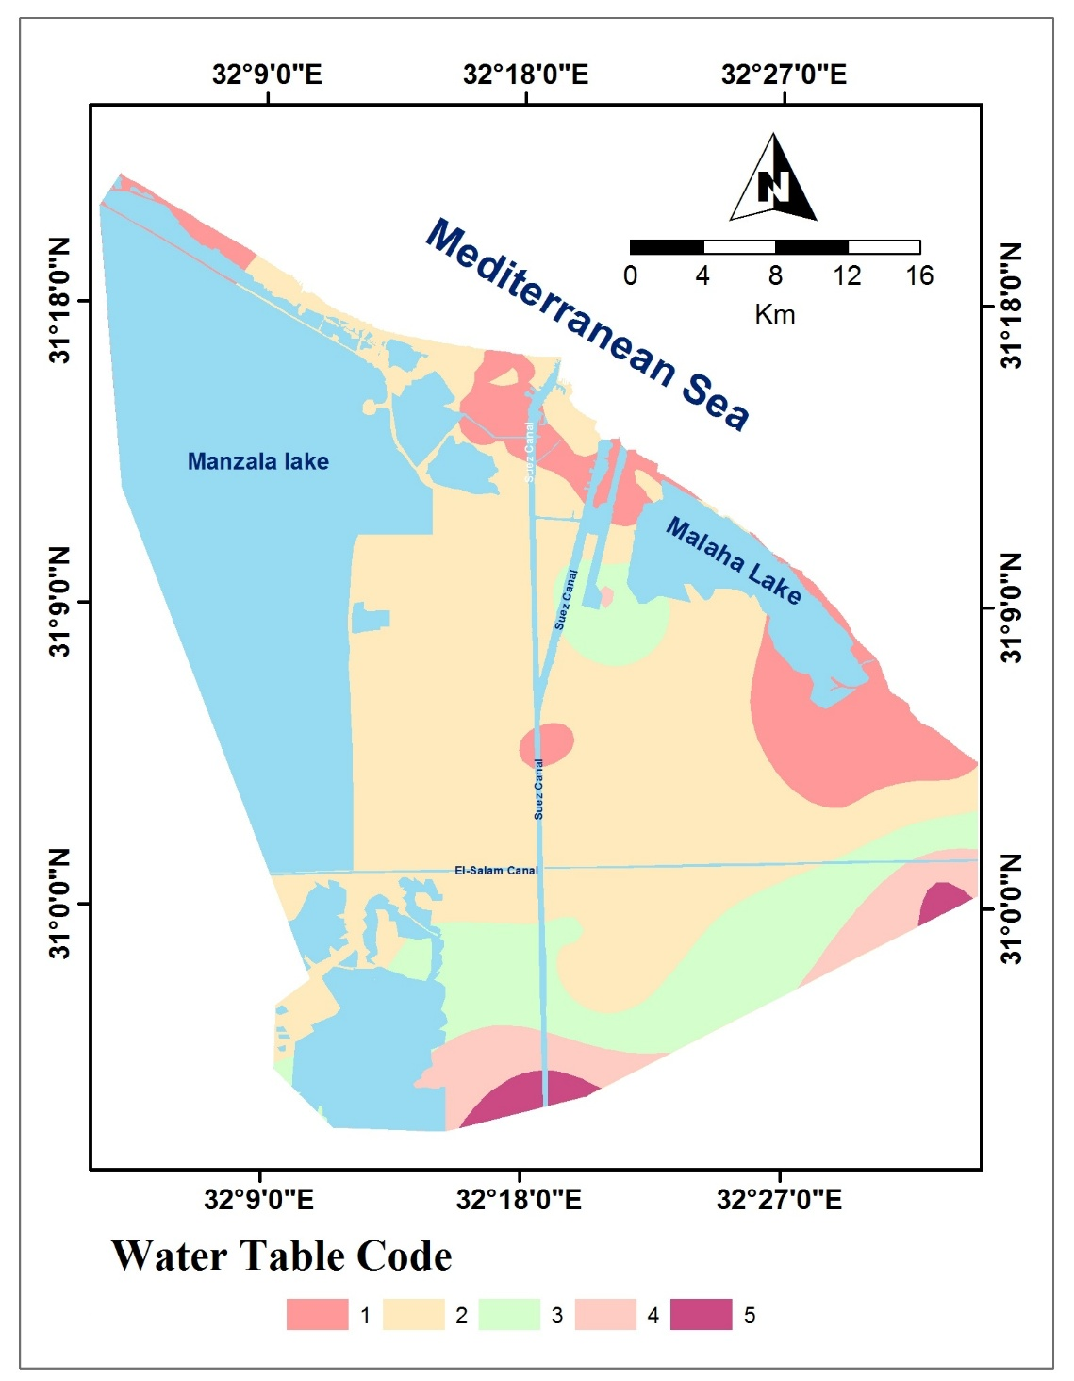
Field &Lab Data
Hydrogeology: Groundwater chemistry & resource Code

Slide 16
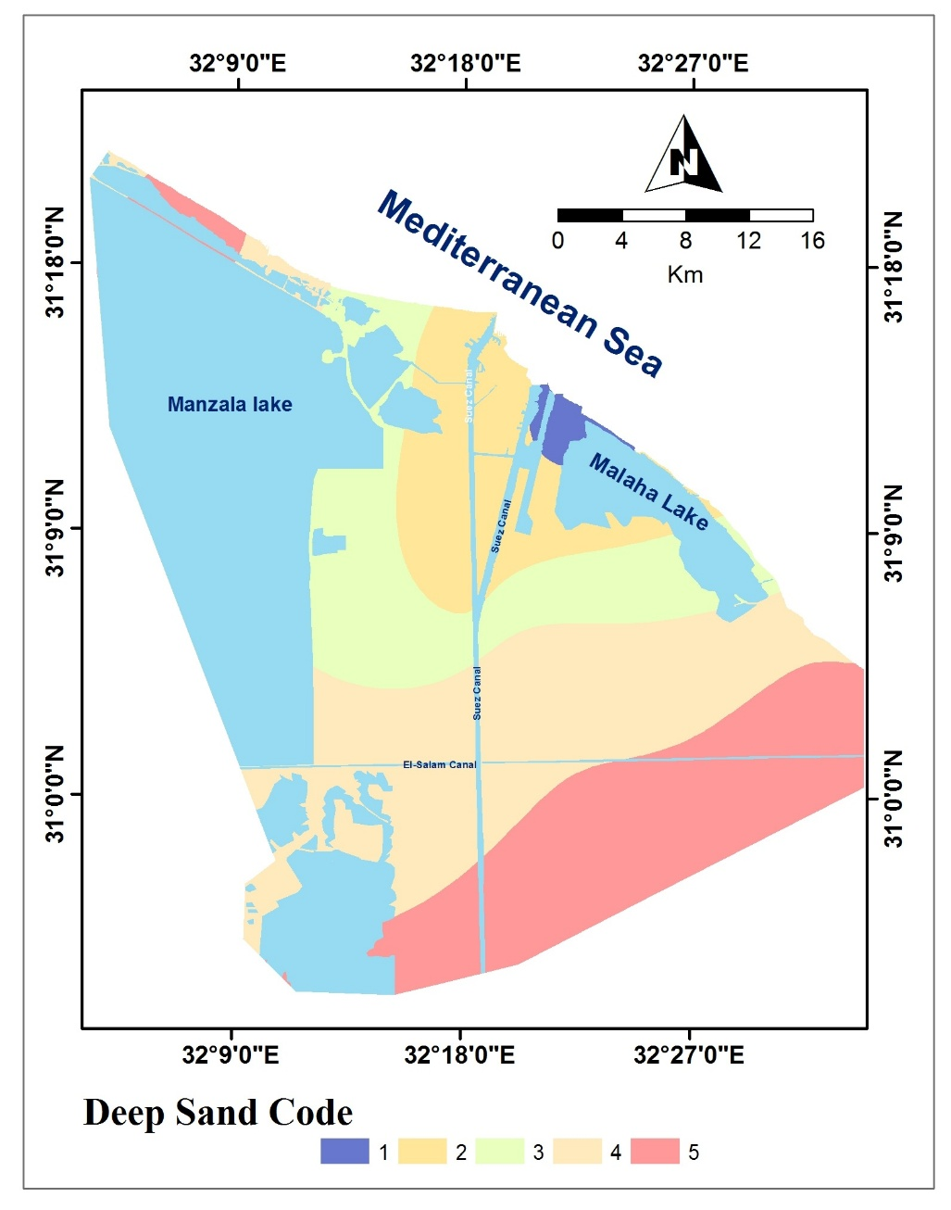
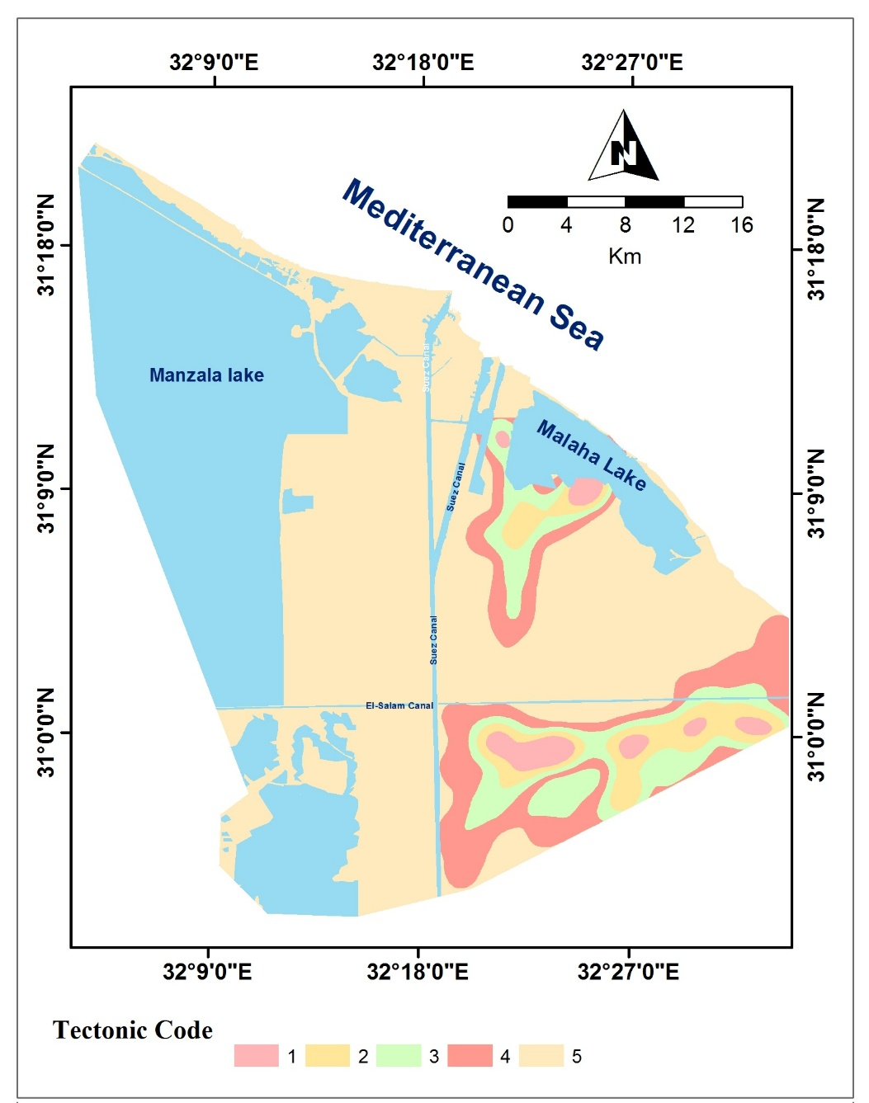
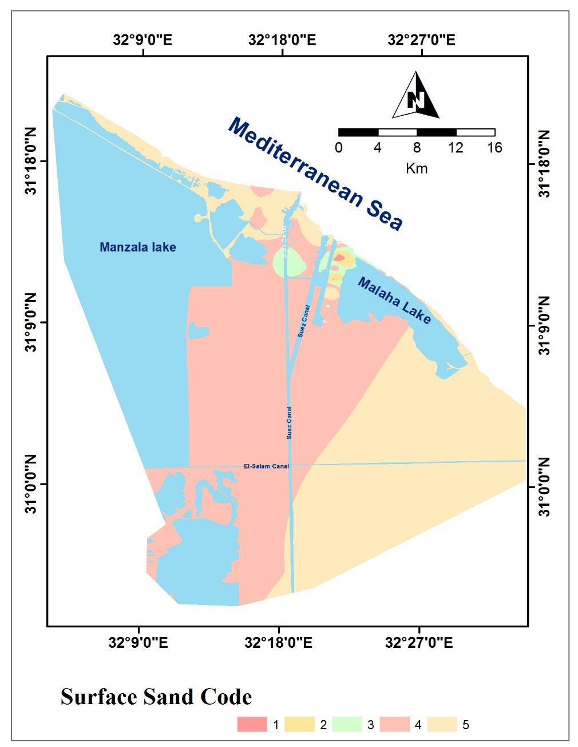
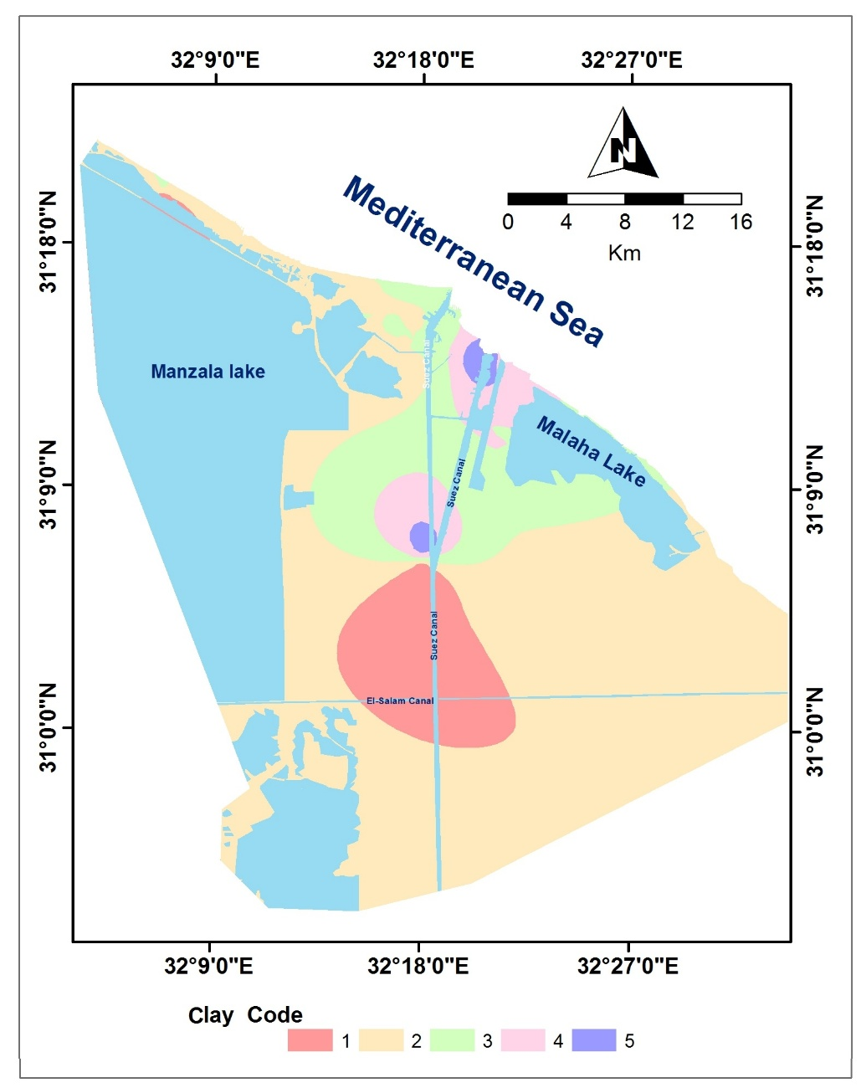
Sub Surface Data
Subsurface Geologic layers Code
Tectonic Framework Code

Slide 17
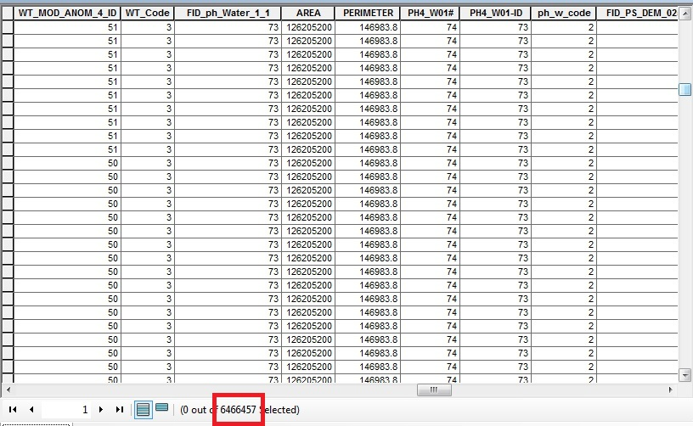
Urban Code

Slide 18
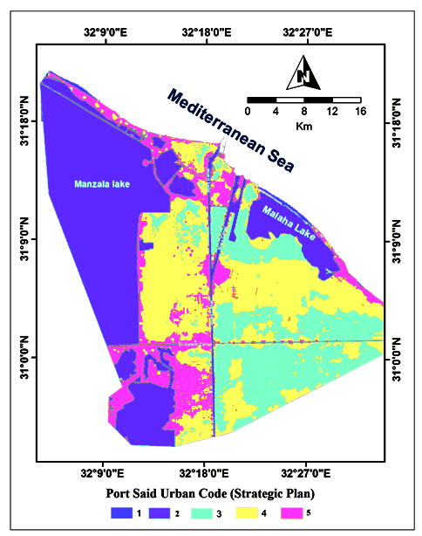
Utilizing All coded Factor Maps
Urban Code Map
Code Suitability Index | Code
Restricted | 1
least suitable | 2
moderately suitable | 3
highly suitable | 4
Ideal | 5

